Slide 2
Chapter 6, LO1, key terms 1
Describe the nervous system
Define the following terms:
central nervous system
the part of the nervous system that is composed of the brain and spinal cord.
peripheral nervous system
part of the nervous system made up of the nerves that ex­tend throughout the body.

Slide 3
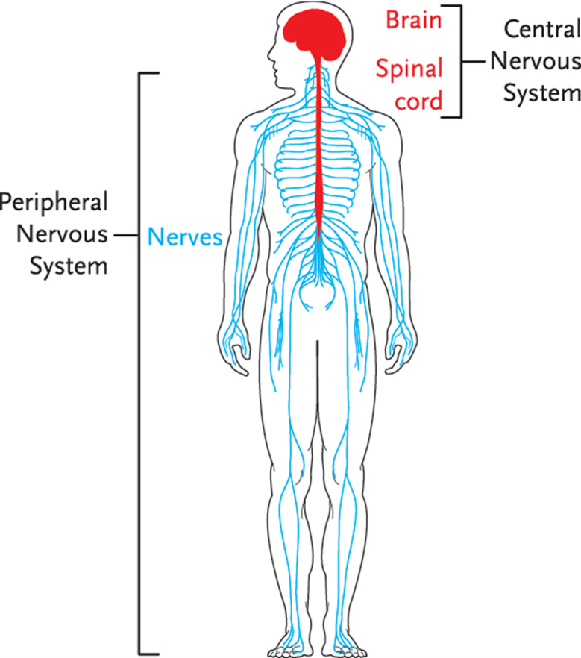
LO1, content 1
Key Material 12-1 The Nervous System

Slide 4
LO1, content 2
Describe the nervous system
Remember these points about the nervous system:
Control and message center of body
Controls and coordinates all body functions
Senses information from outside the body
Two main parts are the central nervous system (brain) and peripheral nervous system (nerves)

Slide 5
LO1, content 3
Describe the nervous system
Normal changes of aging include the following:
Slower responses and reflexes
Decrease in sensitivity of nerve endings in skin
Some memory loss, more often with short-term memory
Reduced vision and hearing (sense of balance may be affected)
Decreased sense of taste, touch, and smell

Slide 6
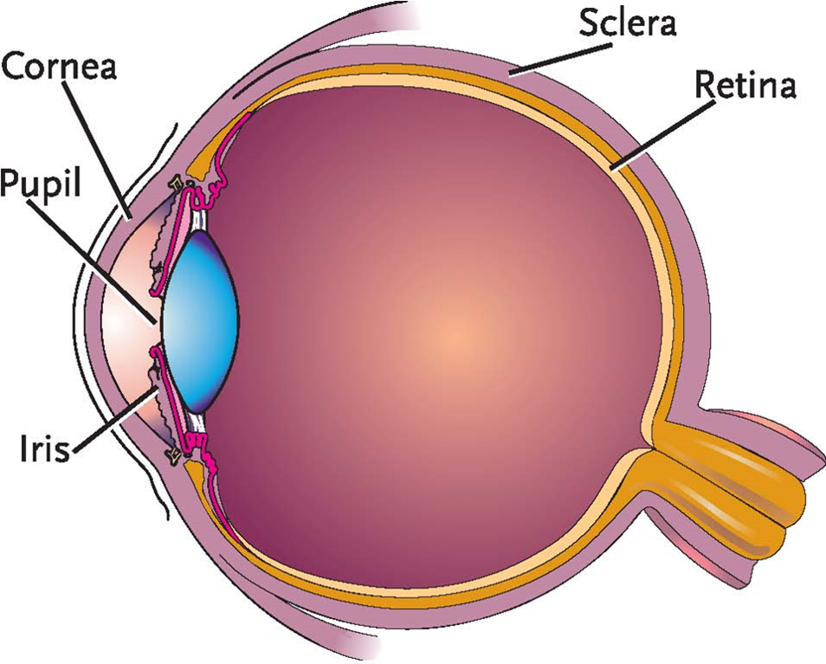
LO1, content 4
Key Material 12-2 Parts of the Eye

Slide 7
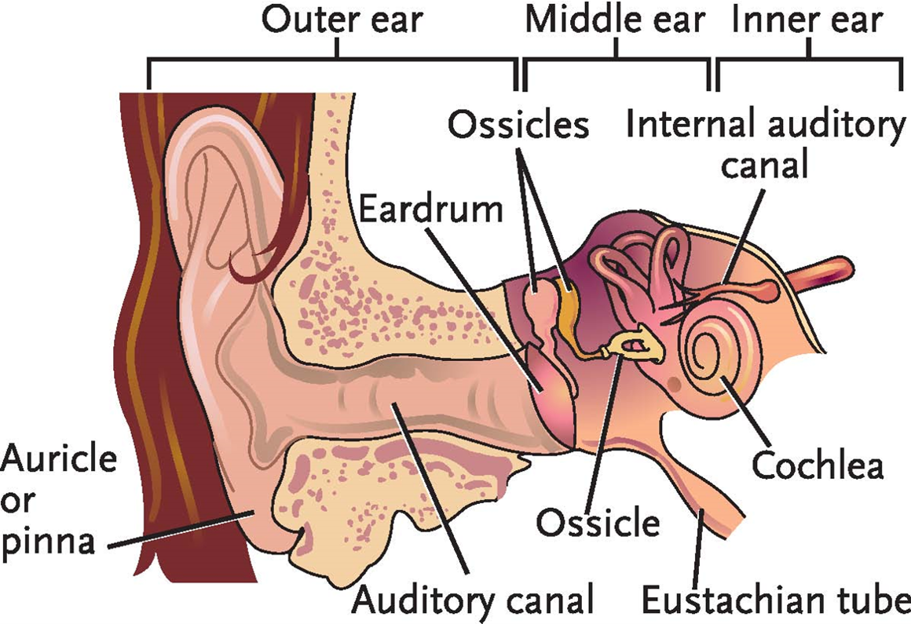
LO1, content 5
Key Material 12-3 Parts of the Ear

Slide 8
LO2, key terms
Discuss common medications used to treat cerebrovascular accident (CVA) and epilepsy
Define the following terms:
cerebrovascular accident (CVA)
a condition that occurs when blood supply to a part of the brain is blocked or a blood vessel leaks or rup­tures within the brain; also called stroke.
transient ischemic attack (TIA)
a warning sign of a CVA/stroke resulting from a temporary lack of oxygen in the brain; symptoms may last up to 24 hours.
epilepsy
a brain disorder that results from a disruption in normal electrical impulses in the brain, which causes repeated seizures.

Slide 9
LO2, content 1
Discuss common medications used to treat cerebrovascular accident (CVA) and epilepsy
Understand the following about treatment for CVA/TIA:
Physical, speech, and occupational therapy may help restore skills in communication and ADLs after CVA
Antiplatelet agents reduce platelet aggregation and prevent strokes
Antiplatelet agents may be ordered after a stroke or as a preventive measure
These measures are important in residents taking antiplatelet agents:
Observe and report signs/symptoms of bleeding
Be aware that NSAIDs may be contraindicated in residents taking antiplatelet agents

Slide 10
LO2, content 2
Discuss common medications used to treat cerebrovascular accident (CVA) and epilepsy
Treatment for CVA/TIA (cont’d):
Statins, a class of medication that lowers cholesterol levels, can reduce stroke risk
Medications to control blood pressure (antihypertensives) may also be ordered. (Chapter 13 has detailed information on these medications)
Table on textbook p. 107 (or handout) details specific drugs

Slide 11
LO2, content 3
Discuss common medications used to treat cerebrovascular accident (CVA) and epilepsy
Care guidelines for CVA include the following:
Know the signs of stroke (FAST acronym):
Face: Is one side of the face drooping?
Arms: Is one arm numb or weak?
Speech: Is the person’s speech slurred?
Time: Time is essential when responding to stroke. Report any signs/symptoms to the nurse immediately
Observe residents taking antiplatelet medications for signs of bleeding (bruising, pallor, bright red blood in vomit or stool, stomach cramps, black/tarry stool). Pallor in darker complexions may be seen in the inside lining of the eyelids, or in the mucous membranes
Be alert if residents are prescribed more than one medication that increases bleeding risk

Slide 12
LO2, content 4
Discuss common medications used to treat cerebrovascular accident (CVA) and epilepsy
Understand the following about treatment for epilepsy:
Treatment can include medication and/or surgery
Antiepileptic drugs may also be called anticonvulsants or antiseizure drugs
Medications work by either increasing calming chemicals in the brain or decreasing chemicals in the brain that excite the nervous system
Benzodiazepines are a class that include several common antiepileptic drugs; not all antiepileptic/anticonvulsant drugs are benzodiazepines

Slide 13
LO2, content 5
Discuss common medications used to treat cerebrovascular accident (CVA) and epilepsy
Treatment for epilepsy (cont’d):
All antiepileptic agents have significant side effects, which can include the following:
Dizziness
Weakness
Drowsiness
Weight loss
Psychiatric reactions including suicidal behavior
Table on textbook p. 107 (or handout) details specific drugs

Slide 14
LO2, content 6
Discuss common medications used to treat cerebrovascular accident (CVA) and epilepsy
Care guidelines for epilepsy include the following:
Observe and report changes in residents’ mental state.
Lamotrigine, an antiepileptic drug, can cause a severe skin condition called Stevens-Johnson syndrome (SJS). Observe and report flu-like symptoms and rash
Phenytoin (Dilantin), an antiepileptic drug, has a narrow therapeutic index. Observe for signs of toxicity including slurred speech, nausea/vomiting, jerky movements (including eye movements), and dizziness/drowsiness

Slide 15
LO3, key terms 1
Discuss common medications used to treat multiple sclerosis, myasthenia gravis, Parkinson’s disease, and Alzheimer’s disease
Define the following terms:
multiple sclerosis (MS)
a progressive disease in which the myelin sheath breaks down over time; causes problems with balance and walk­ing, along with many other symptoms.
myasthenia gravis (MG)
a condition in which impulses from the nerves are not transmitted properly to the musculoskeletal system; causes muscle weakness.
Parkinson’s disease
a progressive, incurable disease that causes a section of the brain to de­generate; causes stiff muscles, stooped posture, shuffling gait, pill-rolling, and tremors.

Slide 16
LO3, key terms 2
Discuss common medications used to treat multiple sclerosis, myasthenia gravis, Parkinson’s disease, and Alzheimer’s disease
Define the following terms:
orthostatic hypotension
a drop in blood pressure when standing up from a seated or supine position.
Alzheimer’s disease
a progressive, incurable disease that causes tangled nerve fibers and pro­tein deposits to form in the brain, which eventu­ally cause dementia.

Slide 17
LO3, content 1
Discuss common medications used to treat multiple sclerosis, myasthenia gravis, Parkinson’s disease, and Alzheimer’s disease
Understand the following about treatment for multiple sclerosis:
Immunomodulatory agents are a drug class that regulates or normalizes the immune system
Side effects of immunomodulatory drugs can include flu-like symptoms, headaches, and depression
Drugs may be prescribed to treat specific symptoms such as muscle spasms (e.g., baclofen)
Corticosteroids can reduce symptoms of MS flare-ups by reducing nerve inflammation
Some medications for MS are administered by injection are so are beyond the scope of practice for medication aides
Table on textbook p. 107 (or handout) details other specific drugs

Slide 18
LO3, content 2
Discuss common medications used to treat multiple sclerosis, myasthenia gravis, Parkinson’s disease, and Alzheimer’s disease
Understand the following about treatment for myasthenia gravis:
Cholinesterase inhibitors can strengthen the signals from the nerves to the muscles
Side effects of cholinesterase inhibitors can include nausea, gas, diarrhea, abdominal pain, and urinary urgency
Side effects are dose-related (increase with higher dose); MA observations/reports can help the care team to determine the best dose
Corticosteroids and immunosuppressants may also be used to treat MG
Residents taking immunosuppressant drugs should be observed closely for signs/symptoms of infection
Table on textbook pp. 107–108 (or handout) details specific drugs

Slide 19
LO3, content 3
Discuss common medications used to treat multiple sclerosis, myasthenia gravis, Parkinson’s disease, and Alzheimer’s disease
Understand the following about treatment for Parkinson’s disease:
Dopamine replacement agents increase a neurotransmitter (brain chemical) related to body movement
Dopamine replacement agents can cause side effects including nausea, dizziness, dry mouth, and orthostatic hypotension
Anticholinergic agents block a neurotransmitter related to involuntary muscle movements and can decrease tremors
Anticholinergic medications can cause dry mouth, constipation, urinary retention, and blurred vision
Table on textbook p. 108 (or handout) details specific drugs

Slide 20
LO3, content 4
Discuss common medications used to treat multiple sclerosis, myasthenia gravis, Parkinson’s disease, and Alzheimer’s disease
Understand the following about treatment for Alzheimer’s disease:
Cholinesterase inhibitors may be ordered
These drugs can cause insomnia (difficulty sleeping), nausea, vomiting, weight loss, and tremors
Transdermal form causes fewer gastrointestinal side effects
Medications that block a substance called NMDA can reduce AD symptoms
Table on textbook p. 108 (and in Appendix E) details specific drugs

Slide 21
LO4, key terms
Discuss common medications used to treat pain and fatigue
Define the following terms:
neuropathic pain
pain caused by illness or damage to the nervous system; sometimes accompanied by tingling or numbness.
chronic fatigue syndrome
fatigue (extreme tiredness) lasting at least six months.

Slide 22
LO4, content 1
Discuss common medications used to treat pain and fatigue
Understand the following about treatment for neuropathic pain:
Treatment depends on the cause of the pain
Local neuropathic pain may be treated with a local anesthetic (numbing agent)
A specific type of antidepressant called a serotonin norepinephrine reuptake inhibitor (SNRI) can relieve neuropathic pain
Opioid medications are prescribed only after other treatments have failed
Table on textbook p. 109 (or handout) details specific drugs

Slide 23
LO4, content 2
Discuss common medications used to treat pain and fatigue
Care guidelines for neuropathic pain include the following:
Remember that not all residents are comfortable discussing pain
Watch for signs of pain. Residents with chronic pain may not show the same signs as people with acute pain. Signs may include
Increased pulse, respirations, and blood pressure
Tightening in the jaw
Squeezing the eyes shut
Restless or agitated behavior

Slide 24
LO4, content 3
Discuss common medications used to treat pain and fatigue
Care guidelines for neuropathic pain (cont’d):
Observe for signs of gastrointestinal bleeding in residents taking NSAIDs (pallor, bloody or black stool)
SNRI antidepressants can cause serotonin syndrome. Signs/symptoms include shivering, diarrhea, muscle rigidity, fever, and seizures
Follow care plan/manufacturer instructions carefully when handling transdermal (patch) opioid medications
Observe for signs of oversedation in residents taking opioid medications (slow breathing, low oxygen saturation, resident not alert)

Slide 25
LO4, content 4
Discuss common medications used to treat pain and fatigue
Remember these points about chronic fatigue:
Can be caused by a number of conditions (including sleep apnea, insomnia, chronic pain, autoimmune disorders, hormonal imbalance)
Treatment requires identifying underlying problems
Medications vary, according to underlying conditions

Slide 26
LO5, key terms 1
Discuss common medications used to treat mental health disorders
Define the following terms:
mental health disorder
a disorder that affects a person’s ability to function and often causes inappropriate behavior; confusion, disorientation, agitation, and anxiety are all common symptoms.
anxiety
uneasiness, worry, or fear, often about a situation or condition.
major depressive disorder
a type of mood dis­order that causes pain, fatigue, apathy, sadness, irritability, anxiety, sleeplessness, and loss of appetite, as well as other symptoms; also called depression or clinical depression.

Slide 27
LO5, key terms 2
Discuss common medications used to treat mental health disorders
Define the following terms:
bipolar disorder
a type of mood disorder that causes mood swings, changes in energy levels and the ability to function, periods of extreme activity, and periods of extreme depression.
schizophrenia
a type of psychotic disorder that causes problems with thinking, communication, and the ability to manage emotions, make deci­sions, and understand reality.
extrapyramidal symptoms (EPS)
symptoms sometimes caused by antipsychotic medications; can include restlessness, irritation, and involuntary movements such as eye spasms, twisting head, and protruding tongue.

Slide 28
LO5, content 1
Discuss common medications used to treat mental health disorders
Understand the following about treatment for anxiety:
Drugs that reduce anxiety are called anxiolytic drugs
Selective serotonin reuptake inhibitors (SSRIs) and serotonin norepinephrine reuptake inhibitors (SNRIs) enhance chemicals in the brain that stabilize mood; usually the first choice for treating anxiety
SSRIs and SNRIs are associated with an increase in suicidal thoughts when they are first administered. MAs should observe and report any changes in mood
Buspirone is an anxiolytic drug that works by an unknown mechanism
Benzodiazepines enhance a calming brain chemical called GABA; due to sedative and muscle relaxant effects they should be used with caution in people over 65
Table on textbook p. 109 (or handout) details other specific drugs

Slide 29
LO5, content 2
Discuss common medications used to treat mental health disorders
Understand the following about treatment for major depressive disorder:
SSRIs and SNRIs can help stabilize mood and establish feelings of well-being.
Tricyclic antidepressants are prescribed less often due to side effects, including
Dry mouth
Blurred vision
Urinary retention
Constipation
Table on textbook p. 110 (or handout) details specific drugs

Slide 30
LO5, content 3
Discuss common medications used to treat mental health disorders
Understand the following about treatment for bipolar disorder:
Mood stabilizers are often prescribed
Lithium (a mood stabilizer) has a narrow therapeutic index and levels are affected by salt intake
Observe for signs of toxicity in residents taking lithium:
Nausea
Weakness
Uncoordinated movements
Confusion
Bipolar disorder may also be treated with a class of drugs known as second-generation antipsychotics
Table on textbook p. 110 (or handout) details other specific drugs

Slide 31
LO5, content 4
Discuss common medications used to treat mental health disorders
Understand the following about treatment for schizophrenia:
Treatment includes first- and second-generation antipsychotics
Drug class carries a boxed warning that elderly patients with dementia-related psychosis treated with antipsychotics are at an increased risk of death
First-generation antipsychotics can cause sedation and extrapyramidal symptoms, including
Eye spasms
Twisting head
Protruding tongue
Restlessness
Irritation
Second-general antipsychotics cause fewer EPS, but can cause weight gain, elevated blood sugar, and abnormal blood lipids (fats)
Table on textbook p. 111 (or handout) details specific drugs

Slide 32
LO5, content 5
Discuss common medications used to treat mental health disorders
Care guidelines for mental health disorders include the following:
Immediately report any mention of suicide
Report any change in mood or behavior
Understand that it takes two to four weeks for antidepressants to decrease depressive mood; physical symptoms may improve before mood-related symptoms
Observe and report drowsiness, nausea, and headache. Medications may need to be adjusted.

Slide 33
LO5, content 6
Discuss common medications used to treat mental health disorders
Care guidelines for mental health disorders (cont’d):
Watch residents who take benzodiazepines closely for signs/symptoms of sedation
Watch residents who take lithium for signs/symptoms of lithium toxicity (nausea, diarrhea, slurred speech, weakness, and/or confusion). Report to the nurse immediately
Bleeding is a risk for residents taking SSRIs/SNRIs and anticoagulants or antiplatelet agents. Watch for signs of excessive bleeding
SSRIs/SNRIs can cause serotonin syndrome. Report shivering, diarrhea, fever, seizures, muscle rigidity

Slide 34
LO5, key terms 1
Discuss common medications used to treat conditions of the sense organs
Define the following terms:
cataract
a condition in which cloudy spots develop in the lens of the eye, causing vision loss.
glaucoma
a disease in which increased pressure inside the eye causes damage that often leads to vision loss and blindness.
age-related macular degeneration (AMD)
a condition in which the macula gradually deterio­rates, causing vision loss and problems such as the inability to recognize faces, drive, read, and write.

Slide 35
LO5, key terms 2
Discuss common medications used to treat conditions of the sense organs
Define the following terms:
conjunctivitis
inflammation of the lining of the eyelid; may be caused by bacteria, viruses, allergies, or foreign objects/substances; also called pink eye.
acute otitis media
infection of the middle ear.
cerumen
medical term for earwax.

Slide 36
LO5, content 1
Discuss common medications used to treat conditions of the sense organs
Understand the following about treatment for cataracts:
Corrected with surgery
After surgery NSAID eye drops or ointment is usually prescribed to prevent inflammation
Table on textbook p. 111 or handout) details specific drugs

Slide 37
LO5, content 2
Discuss common medications used to treat conditions of the sense organs
Understand the following about treatment for glaucoma:
Treated with eye drops that either increase the flow of fluid out of the eyes or reduce the production of eye fluid (both decrease pressure in the eye)
Residents may not understand even if they are not experiencing symptoms, the medication is important to prevent vision loss
Table on textbook pp. 111–112 (or handout) details specific drugs

Slide 38
LO5, content 3
Discuss common medications used to treat conditions of the sense organs
NOTE:
Antioxidant vitamins and zinc supplements may be ordered to slow the progression of age-related macular degeneration. Later stages require medications injected into the eye (performed by a specialist)

Slide 39
LO5, content 4
Discuss common medications used to treat conditions of the sense organs
Understand the following about treatment for dry eyes:
Lack of lubrication can increase the risk of eye infections and can damage the surface of the eye, so treatment is important
Eye drops or ointments formulated to act as tears (artificial tears) are ordered
Table on textbook p. 112 (or handout) details specific drugs

Slide 40
LO5, content 5
Discuss common medications used to treat conditions of the sense organs
Understand the following about treatment for conjunctivitis:
Antibiotic eye drops or ointment are commonly prescribed
Contact Precautions must be used, as conjunctivitis is very contagious
Table on textbook p. 112 (or handout) details specific drugs

Slide 41
LO5, content 6
Discuss common medications used to treat conditions of the sense organs
Understand the following about treatment for acute otitis media (ear infection):
Ear infections may resolve on their own
Ear pain can be relieved with analgesics (OTC NSAIDs, acetaminophen)
Antibiotics are prescribed if the infection does not resolve
Table on textbook pp. 112–113 (or handout) details specific drugs

Slide 42
LO5, content 7
Discuss common medications used to treat conditions of the sense organs
Understand the following about treatment for cerumen (earwax) buildup:
Cerumenolytics are earwax softeners
Softeners are put in the ears by dropper and allowed to soften earwax
Ear is then flushed with warm water using a bulb syringe
Do not remove ear wax with cotton swabs or insert any object in the ear
Do not use “ear candles;” they are not effective and can be dangerous
Table on textbook p. 113 (and in Appendix E) details specific drugs

